Slide 1


星露谷风格农场游戏
2353127 曹津硕 (组长)
2351493 胡浩杰
2353741 胡正华
GitHub: https://https://github.com/Jackey0903/Stardew-Valley

Slide 2

01.
Brief Introduction
02.
General Design
CONTENTS
03.
C++ 11
New Features
04.
Conclusion &Review

Slide 3
01.
Brief Introduction
ENGLISH COURSE

Slide 4
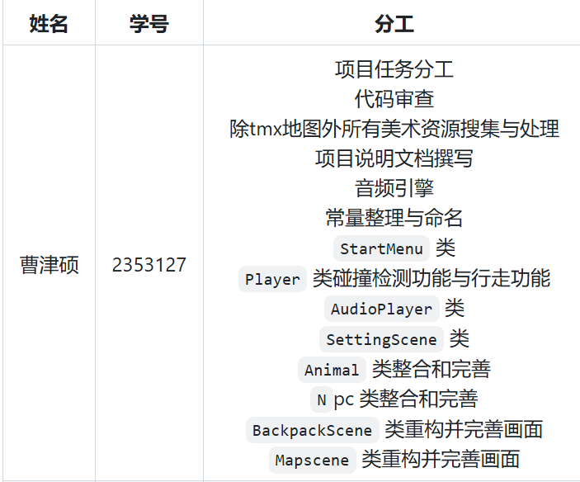
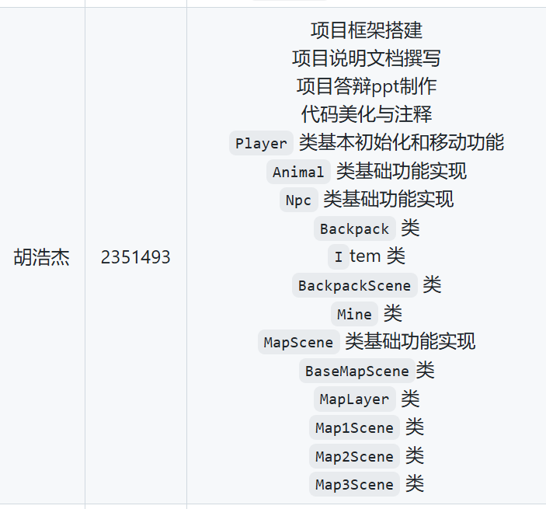

Group Work

Slide 5




Technology tools
Cocos2d-x 3.17.2
C++
Git
Android
Main advantages of Cocos2d-x are cross platform, high performance, high compatibility, hot updates, customizability, and ease of use.
When developing games within the Cocos2d framework using the C++language, it provides performance advantages and flexibility.
Git supports team collaboration, aiding teams in working together more efficiently
The game has also been ported to the Android platform,achieving dual platform development

Slide 6


Main Function

Slide 7


Slide 8
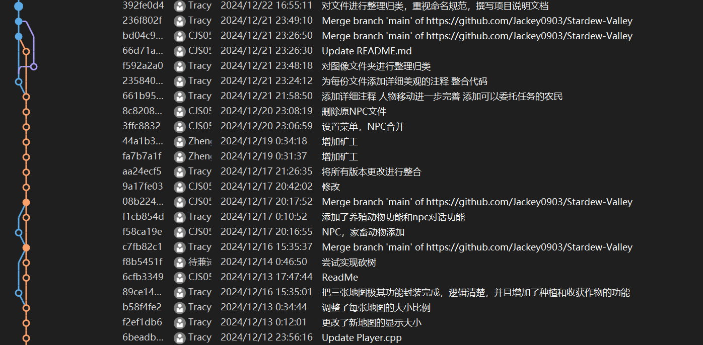
Excellent version control
Clear branches, efficient collaborative development

Slide 9
02.
General Design
ENGLISH COURSE

Slide 10
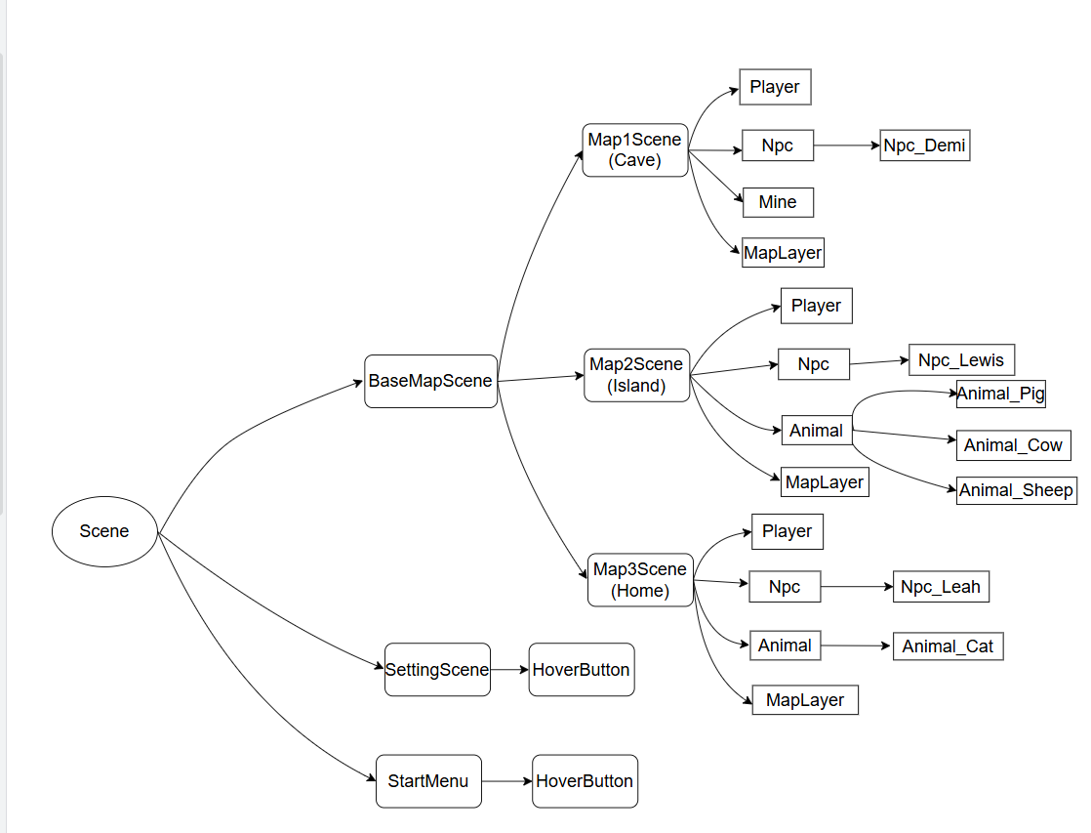

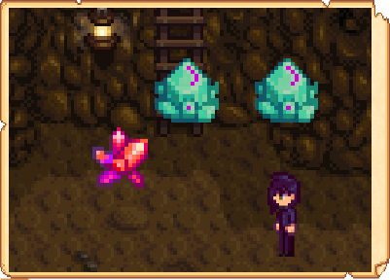



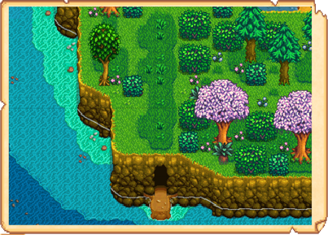



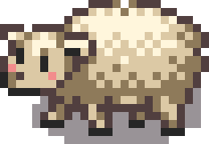
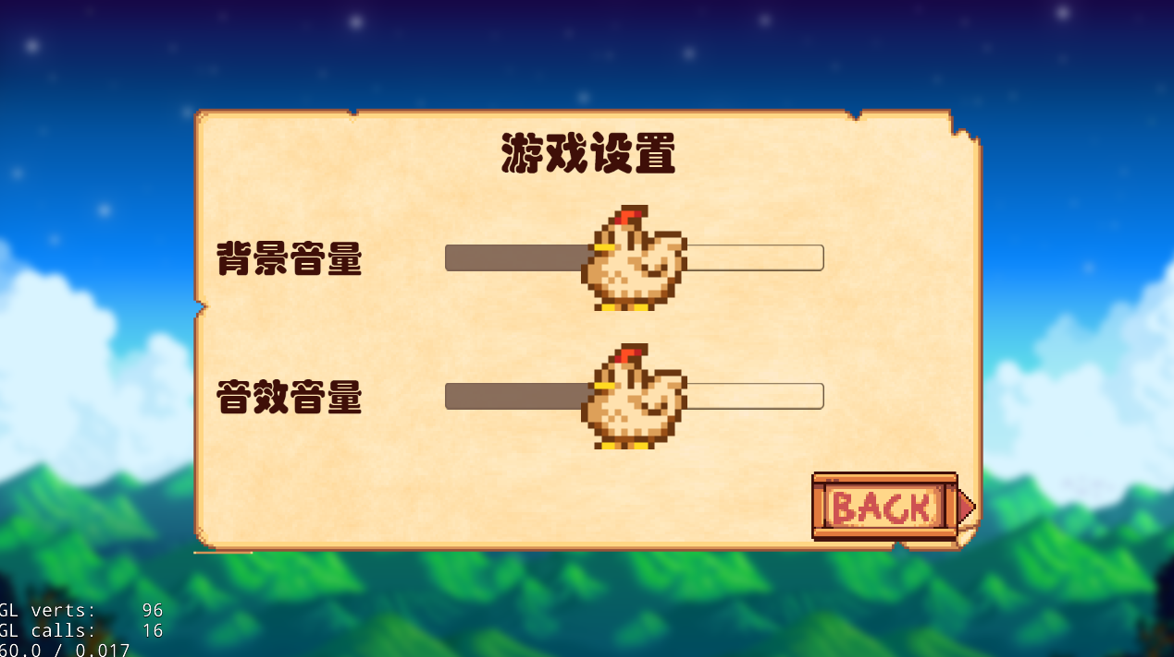



encapsulation&inherit
Class Scene
These scenes inherit from the Scene class, and BaseMapScene is responsible for managing the calls to each scene.

Slide 11
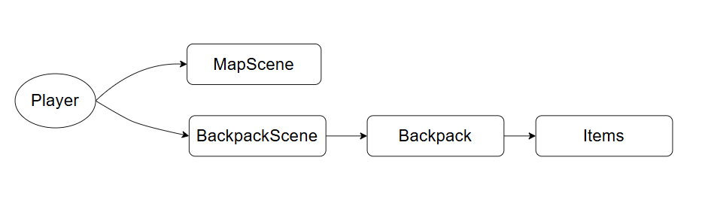
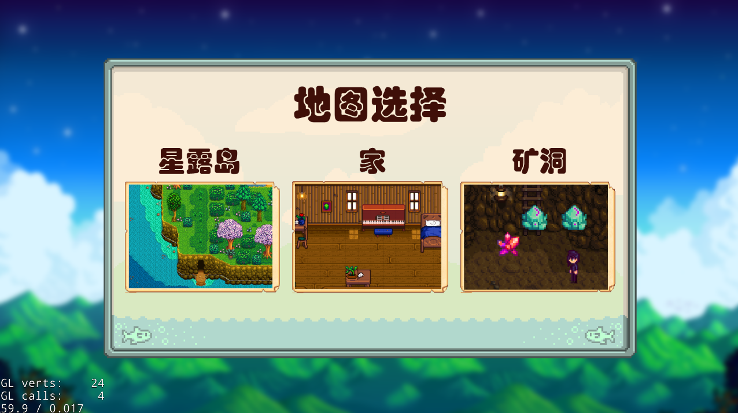
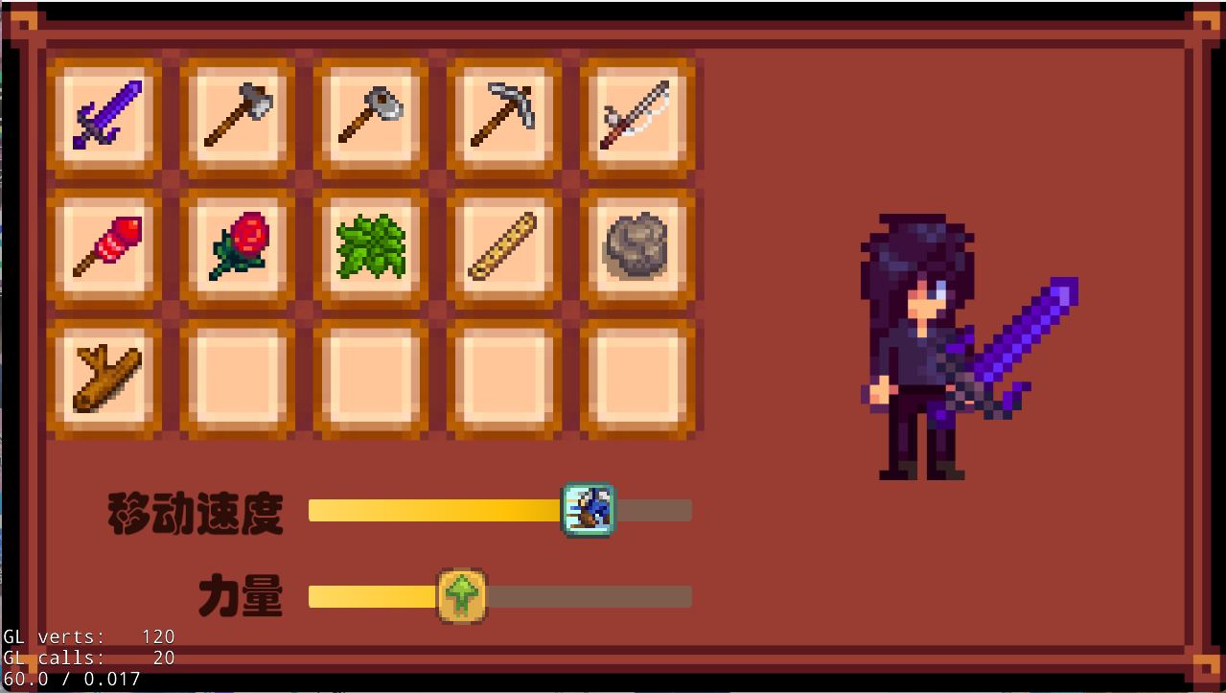
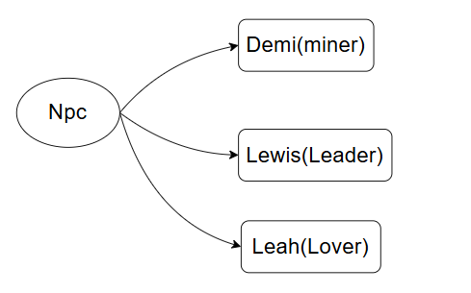
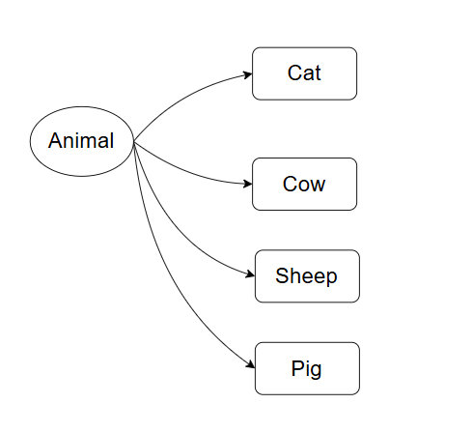
Class Player
Class Npc
Class Animal

Slide 12
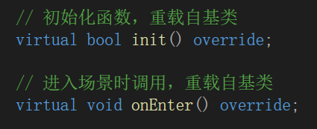
Polymorphism
The code declares a `virtual` function, enabling polymorphism by allowing derived classes to override base class methods. This lets different objects respond uniquely to the same call. When invoked, the object's class implementation runs, enhancing code flexibility and extensibility by managing various types through a unified interface.

Slide 13
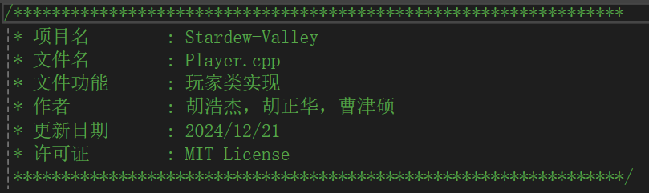
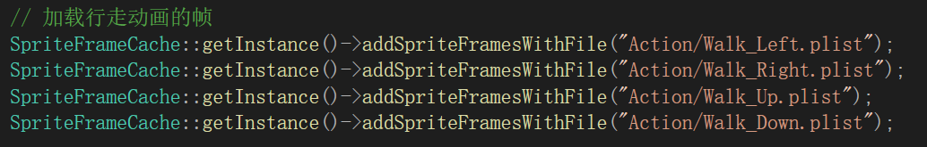
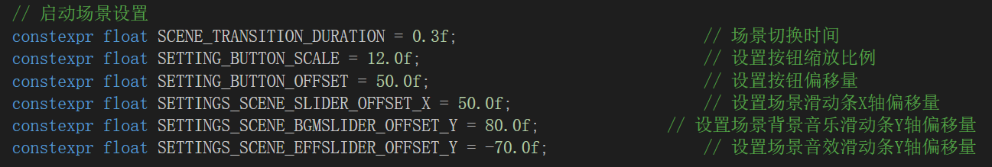
Coding Style
header comment
Good naming conventions
Constant Expression

Slide 14
03.
C++ 11
New Features

Slide 15
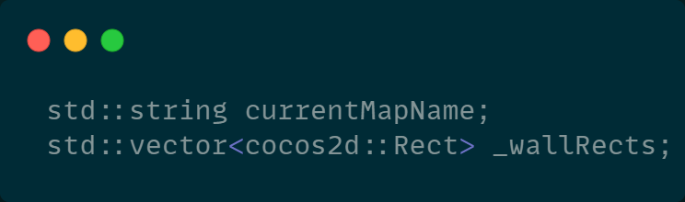
STL Containers
In this project, standard template library (STL) containers such as std::vector, std::list, and std::unordered_map were used. These containers greatly simplified the management of attributes and items while providing efficient storage and access mechanisms. Each container serves a unique purpose:
std::vector ：offers a dynamic array, ideal for frequent access and appending operations.
std::list ：provides a doubly linked list, suitable for frequent insertion and deletion.
std::unordered_map ：implements a hash table structure, offering average constant-time lookups.

Slide 16
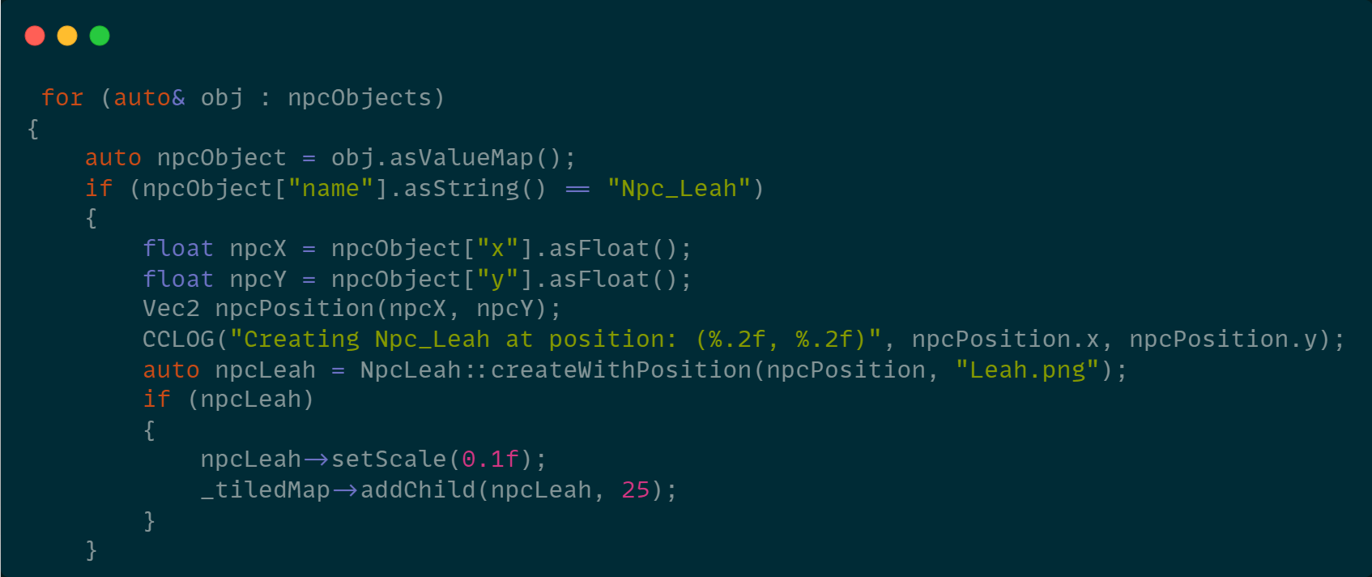
Iterators
Range-based for loops and explicit iterators offer a decoupled mechanism to traverse container elements. For example:
This approach not only simplifies the code but also enhances readability.

Slide 17
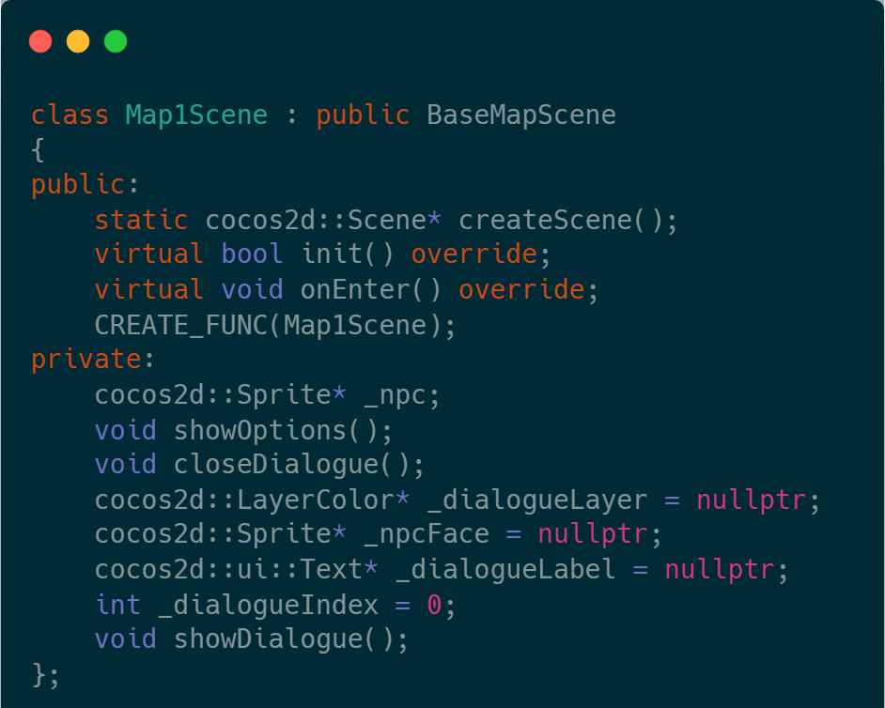
Classes & Polymorphism
Inheritance and polymorphism are used to extend classes and override functionality, adhering to object-oriented design principles. In this project, custom classes inherit from Cocos2d-x framework classes to implement specific features. For instance：
Additionally, virtual functions enable polymorphic behavior, allowing base class pointers to call derived class overrides.

Slide 18
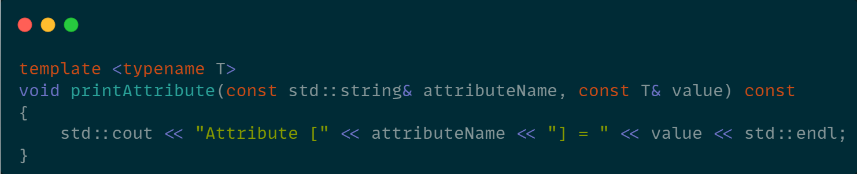
Templates
Template technology was used to implement a generic object manager, improving code reusability. For example：
Combining std::unique_ptr with polymorphism enables type erasure, allowing unified management of objects of different types.

Slide 19
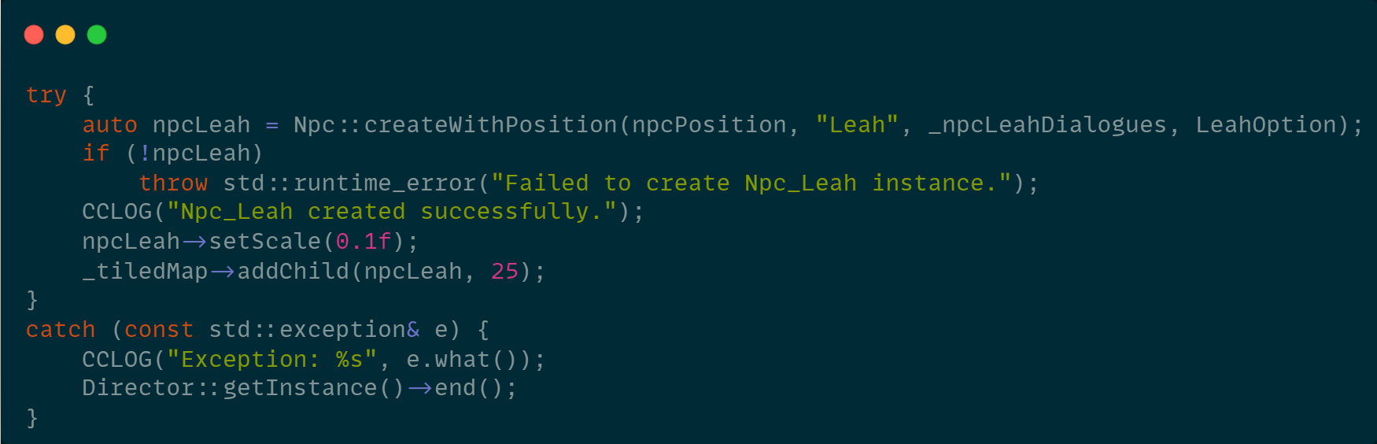
Exception Handling
try-catch statements capture runtime errors, ensuring graceful handling in exceptional cases. For instance:

Slide 20
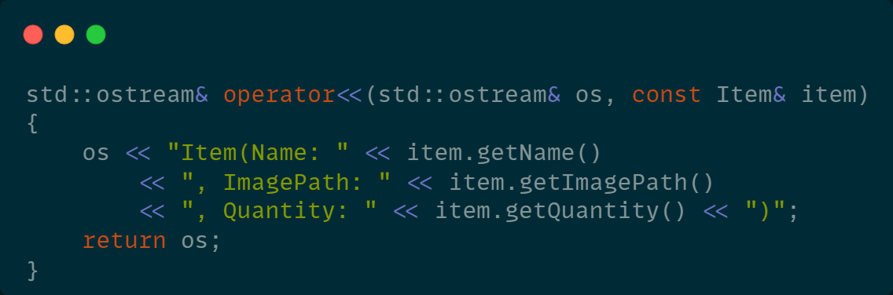
Function & Operator Overloading
In this project, function and operator overloading were used to make the code more intuitive and maintainable. Operator overloading allows developers to define the behavior of operators for custom data types, enabling them to be used in expressions just like built-in types. For example:

Slide 21
04.
Conclusion and Review

Slide 22
Challenges & Solutions
1.Game State Management
We inherited from Cocos2d-x's Scene class to seamlessly switch and manage different game scenes.
2.Data Structure Design
Using std::unordered_map and std::vector allowed for efficient storage and access, ensuring good performance.
3.Scalability
Object-oriented design helped keep the code clean and extensible, making it easy to add new features.

Slide 23
Gains & Improvements
Gains
1.Application of Object-Oriented Design
Throughout the project, I gained a deeper understanding and practical experience of core object-oriented programming (OOP) concepts such as encapsulation, inheritance, polymorphism, and abstraction. These principles allowed us to modularize the complex game system, reduce code redundancy, and improve maintainability and scalability.
2.Proficiency with Game Engine
Using the Cocos2d-x engine for game development provided valuable experience, especially in scene management, animation effects, and event handling. The features offered by Cocos2d-x enabled us to quickly establish the basic framework of the game, laying a solid foundation for future optimizations and expansions.

Slide 24
Gains & Improvements
Improvements
1.Code Structure Optimization
While object-oriented design provided a good architecture, some modules became overly verbose during development, which made maintenance challenging. In the future, further optimization of module division and reducing class dependencies will improve code clarity and scalability.
2.UI/UX Design Improvements
The user interface and interaction design of the game can be enhanced. The current UI is relatively simple and lacks detailed polishing. More animations and interactive feedback can be introduced to improve the user experience.

Slide 25



SINCERE APPRECIATION

